Slide 1
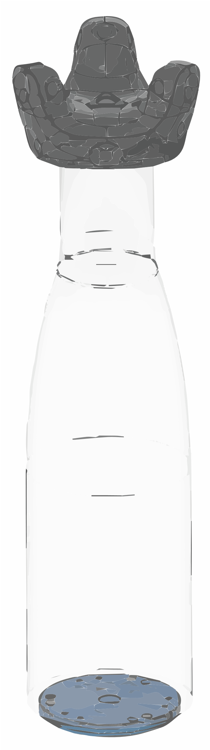
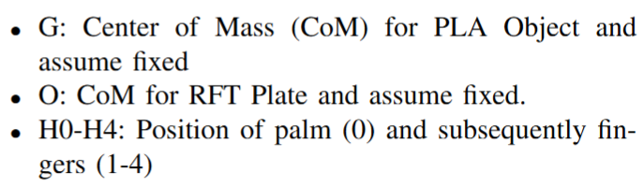
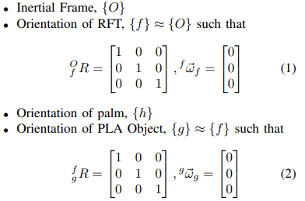
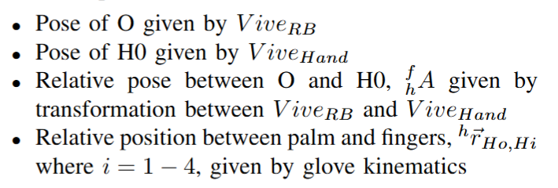
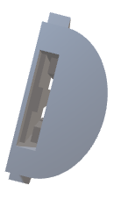
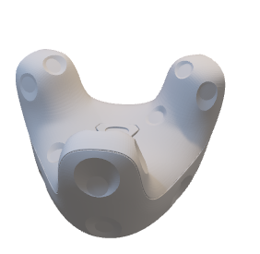
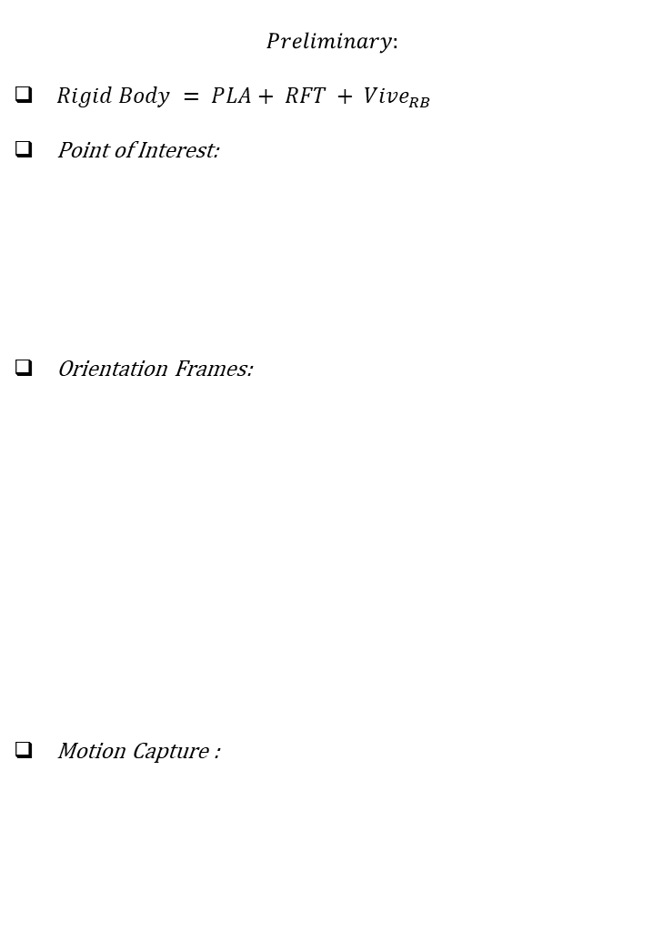
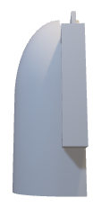
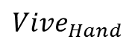

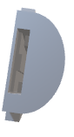
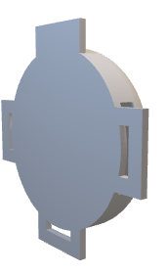
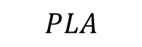
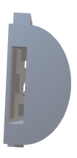
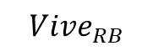
Study 1: Interaction Force and Torque on Static Rigid Body
$$Preliminary:$$
$Rigid Body = PLA+ RFT + Vive_{RB}$
Point of Interest:
Orientation Frames:
Motion Capture :
$$Vive_{RB}$$
$$PLA$$
H2
H1
G
{g}
H3
$$Vive_{Hand}$$
{h}
H0
Z
H4
Point
{frame}
X
{O,f}
O
Y
$$RFT$$
Notes:
Include FBD, standardize the notations, for the static rigid body, start overleaf project to write the maths properly

Slide 2
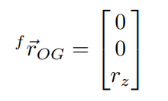
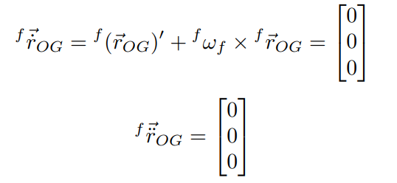
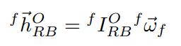
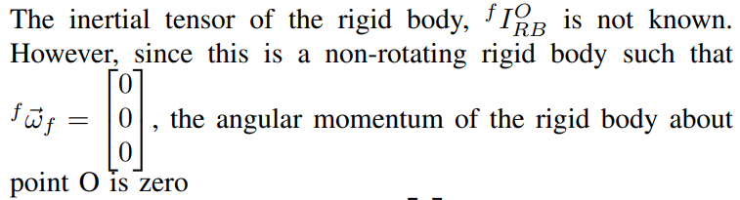
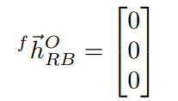
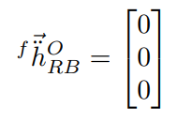


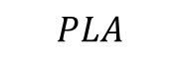
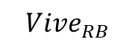
Kinematics
Linear
$$Vive_{RB}$$
$$PLA$$
H2
H1
Angular
G
{g}
H3
$$Vive_{Hand}$$
{h}
H0
Z
H4
Point
{frame}
X
{O,f}
O
Y
$$RFT$$
Notes:
Include FBD, standardize the notations, for the static rigid body, start overleaf project to write the maths properly

Slide 3
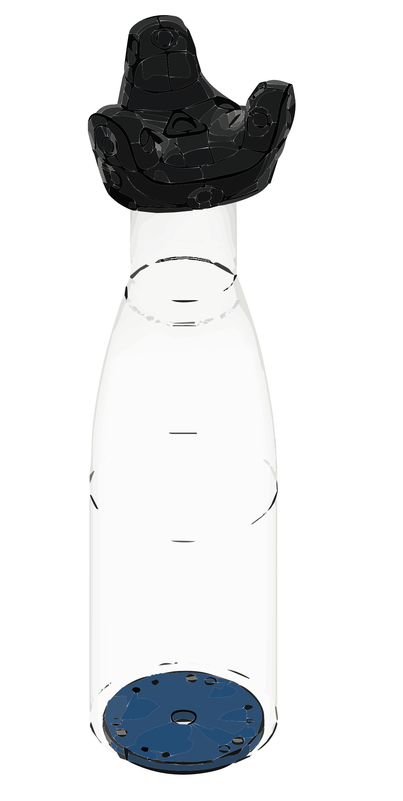


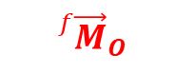





Dynamics (Free Body Diagram)
$${}_{}^{h}{{\vec{F}}_{2}}$$
H2
$${}_{}^{h}{{\vec{F}}_{1}}$$
H1
$${}_{}^{h}{{\vec{F}}_{3}}$$
{h}
H3
{g}
H0
$${}_{}^{h}{{\vec{F}}_{0}}$$
G
$${}_{}^{h}{{\vec{F}}_{4}}$$
$${}_{}^{f}{{\vec{F}}_{G}}$$
H4
Actuation Wrenches
Constraint Wrenches
Gravitational Wrenches
{f}
O
$${}_{}^{f}{{\vec{F}}_{O}}$$
$${}_{}^{f}{{\vec{M}}_{O}}$$
Notes:
Include FBD, standardize the notations, for the static rigid body, start overleaf project to write the maths properly

Slide 4
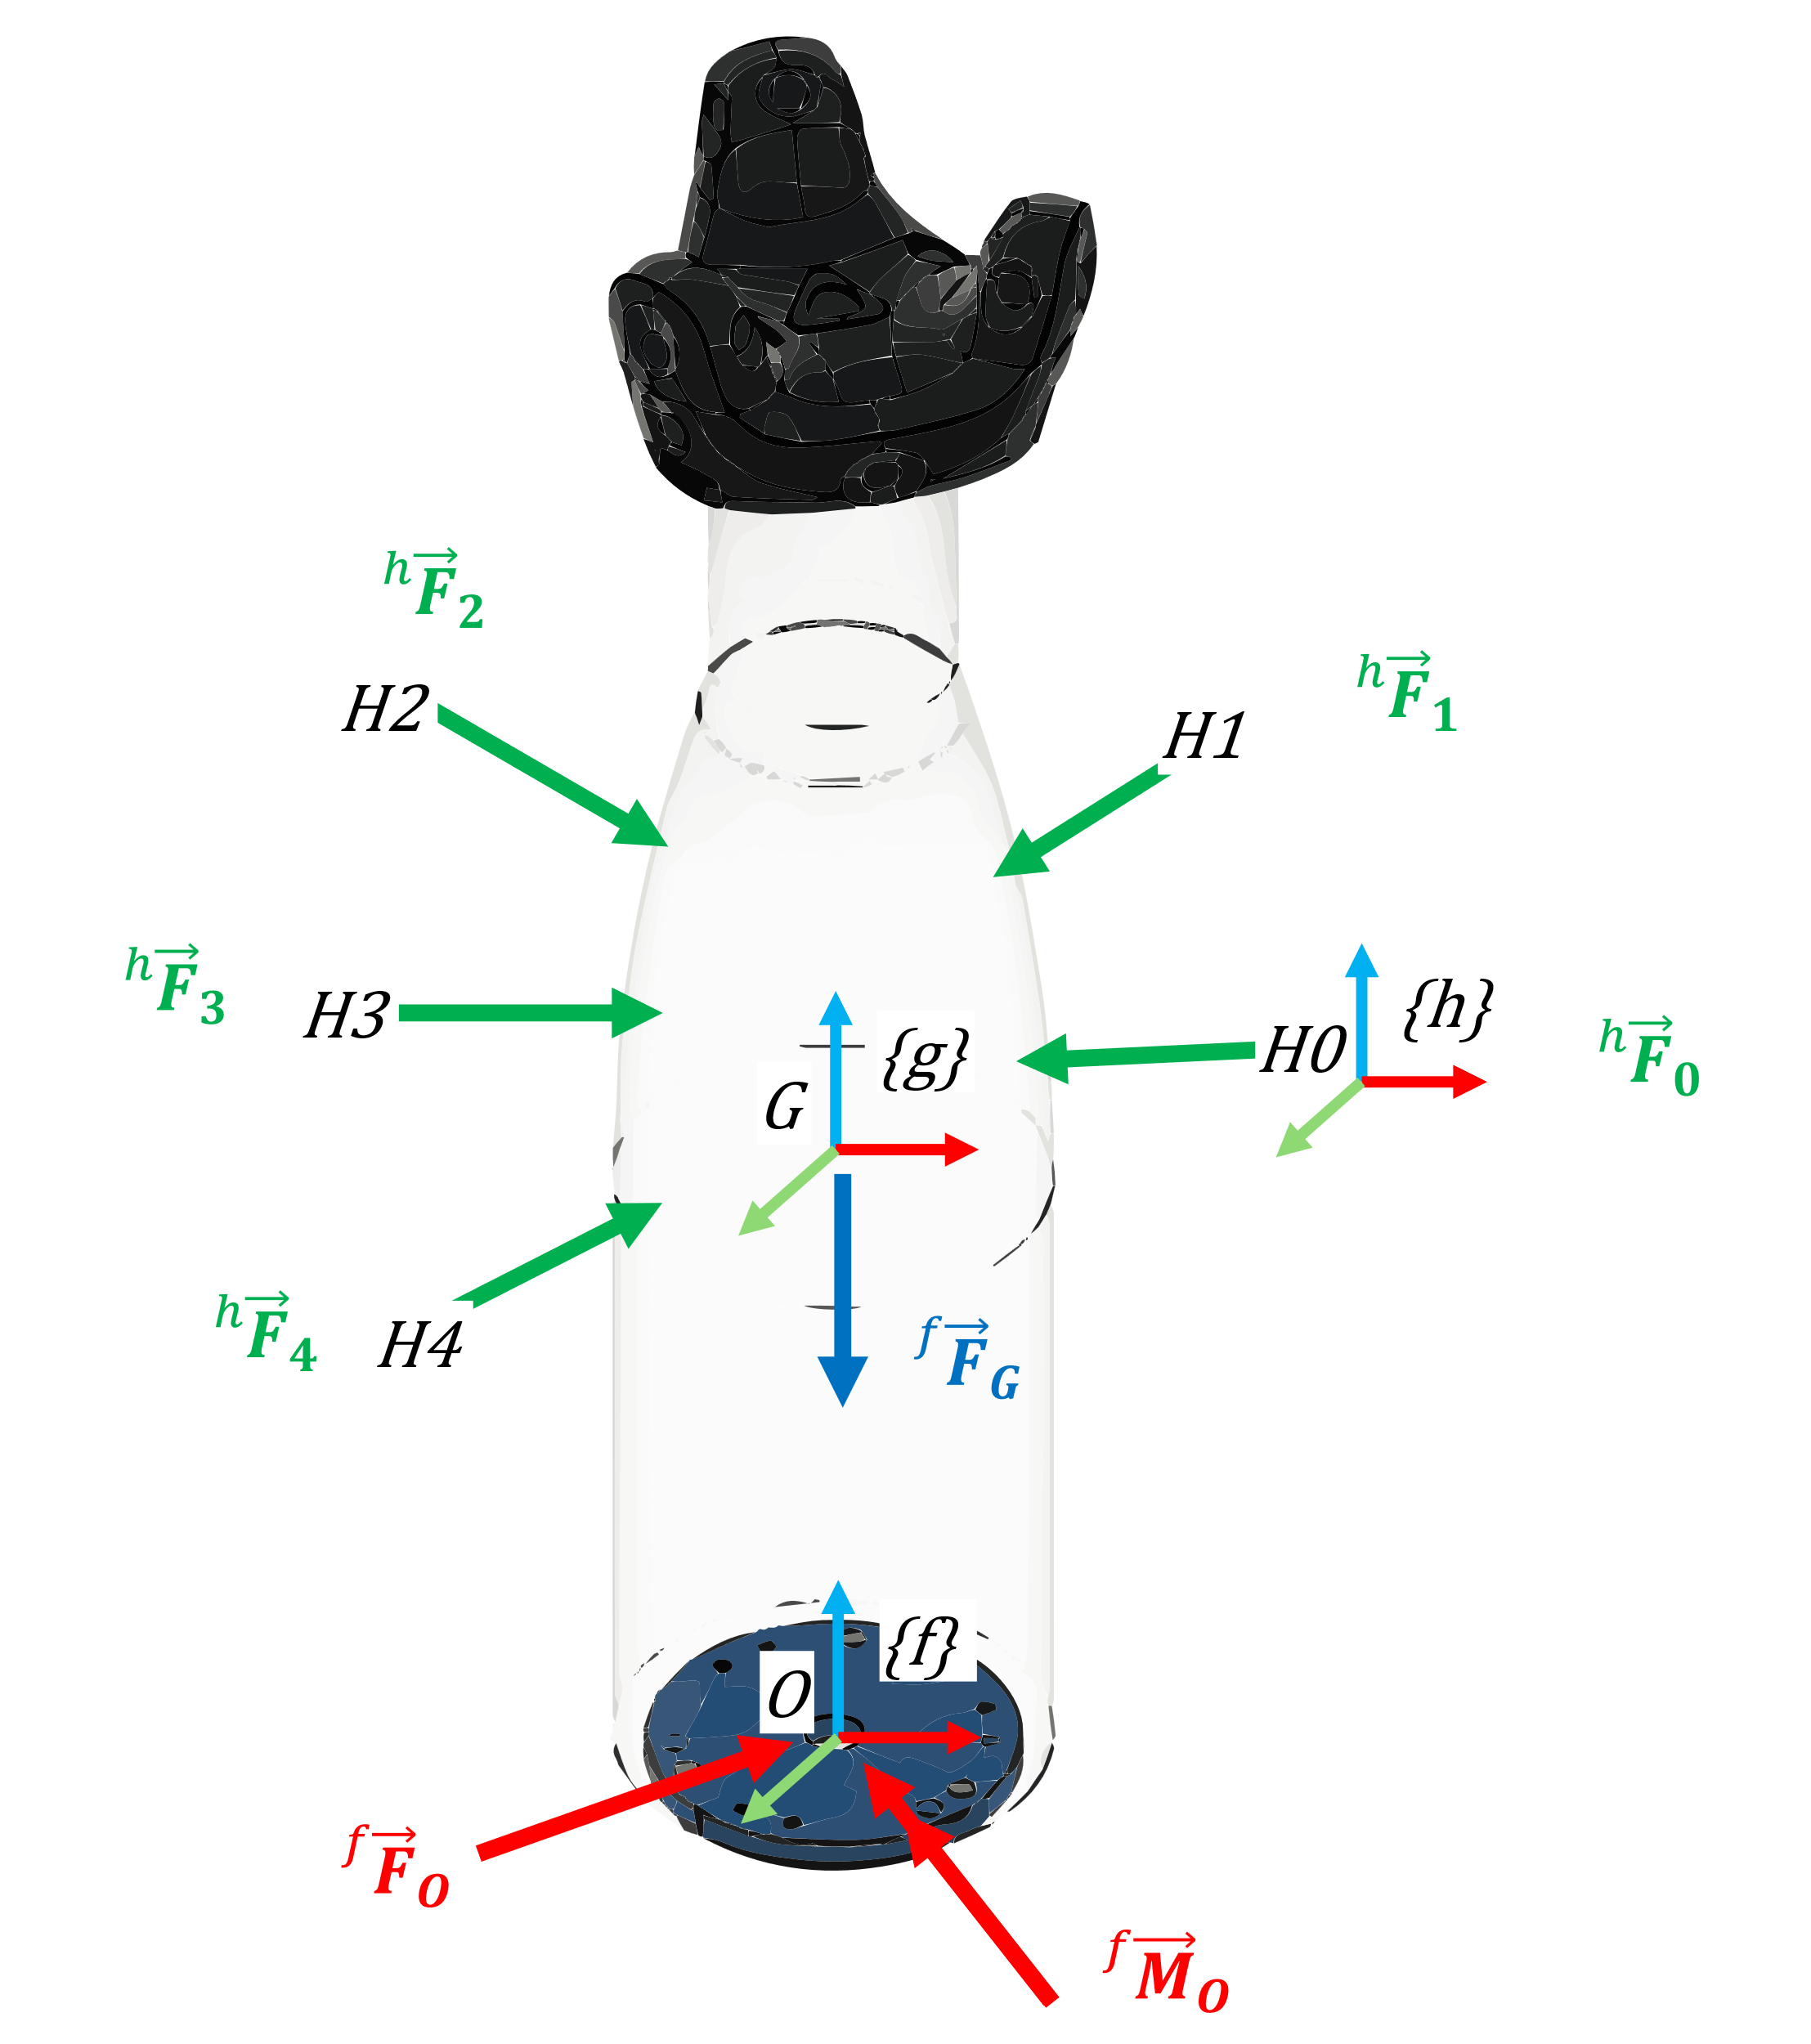
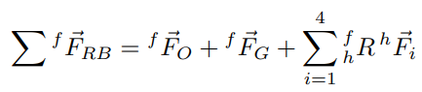
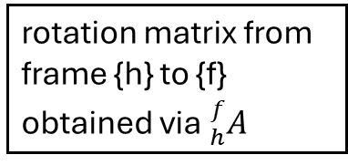
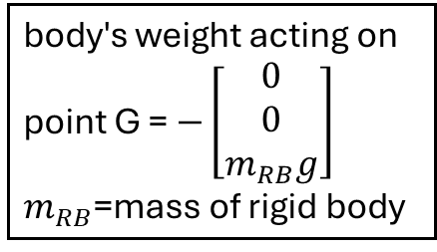
Dynamics (Resultant Forces)
body's weight acting on point G = $−\left[\begin{matrix}0 \\ 0 \\ m_{RB}g\end{matrix}\right]$
$m_{RB}$=mass of rigid body
constraint forces acting on point O
rotation matrix from frame {h} to {f} obtained via ${}_{h}^{f}A$
driving forces acting on the rigid body from a manipulator's hand / fingers expressed in frame {h}
Notes:
Include FBD, standardize the notations, for the static rigid body, start overleaf project to write the maths properly

Slide 5
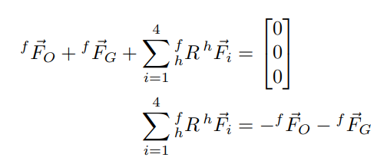
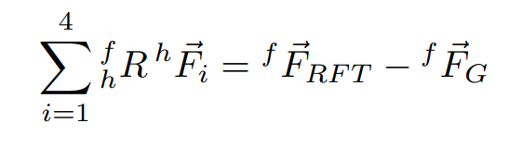
Dynamics (Linear NE)
RFT F/T sensor measures the forces acting on point O, in the opposite direction of the constraint force
Notes:
Include FBD, standardize the notations, for the static rigid body, start overleaf project to write the maths properly

Slide 6
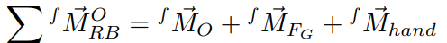
Dynamics (Resultant Moment)
constraint moments acting about point O
Moment about point O induced by body’s weight
Moment about point O induced by driving forces acting on the rigid body a manipulator's hand / fingers.
Notes:
Include FBD, standardize the notations, for the static rigid body, start overleaf project to write the maths properly

Slide 7
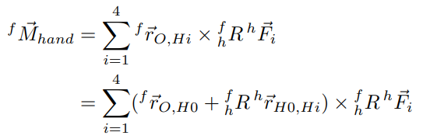
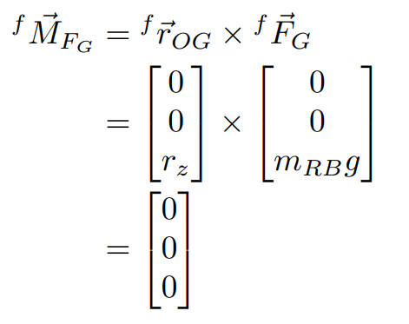
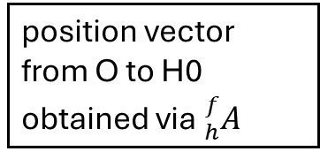
Dynamics (Resultant Moment)
position vector from O to H0 obtained via ${}_{h}^{f}A$
relative position from palm to finger given by glove
Notes:
Include FBD, standardize the notations, for the static rigid body, start overleaf project to write the maths properly

Slide 8
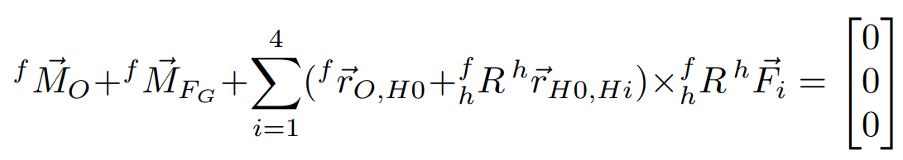
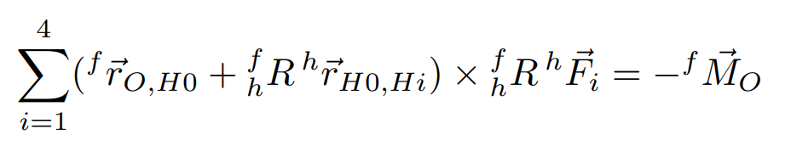
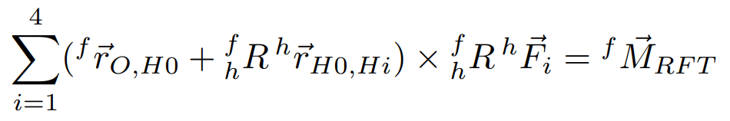
Dynamics (Angular NE)
RFT F/T sensor measures the moment acting on point O, in the opposite direction of the constraint moment
Notes:
Include FBD, standardize the notations, for the static rigid body, start overleaf project to write the maths properly

Slide 9
Summary
Experimental validation of the interaction on a STATIC RIGID BODY
force and position readings of the glove
and the wrench readings from the RFT F/T sensor has to satisfy
Notes:
Include FBD, standardize the notations, for the static rigid body, start overleaf project to write the maths properly

Slide 10
Validation of the left side of the equation
Experiment Protocol
Subject size
Output metrics (IEEE sensors evaluation, performance)

